Slide 1
Myan Persistance

Slide 2
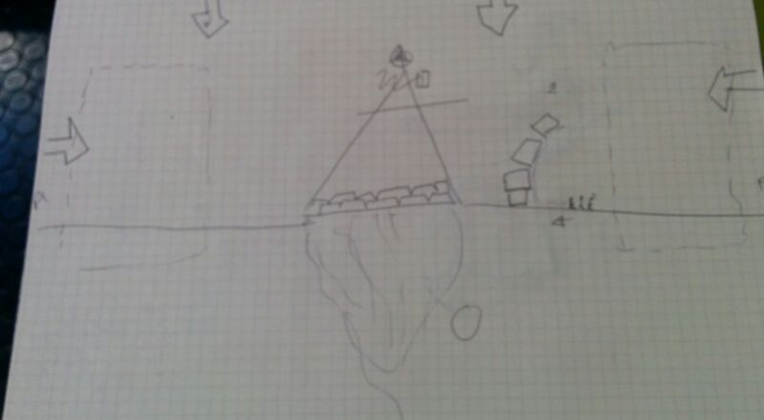
Concept

Slide 3
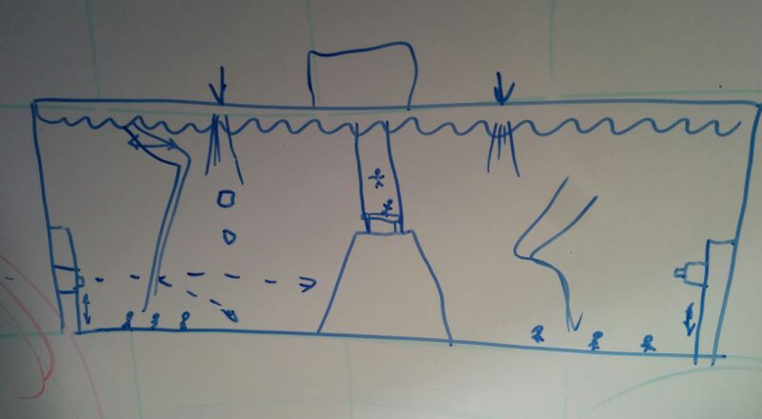
Concept

Slide 4
Main Features
2 players.
Each player uses blocks to try and block the other player’s people.
Each player has a canon to destroy the blocks.

Slide 5
Extension Ideas
Background drum speeding up as time running out.
Button with voiceover for instructions for accessibility.

Slide 6
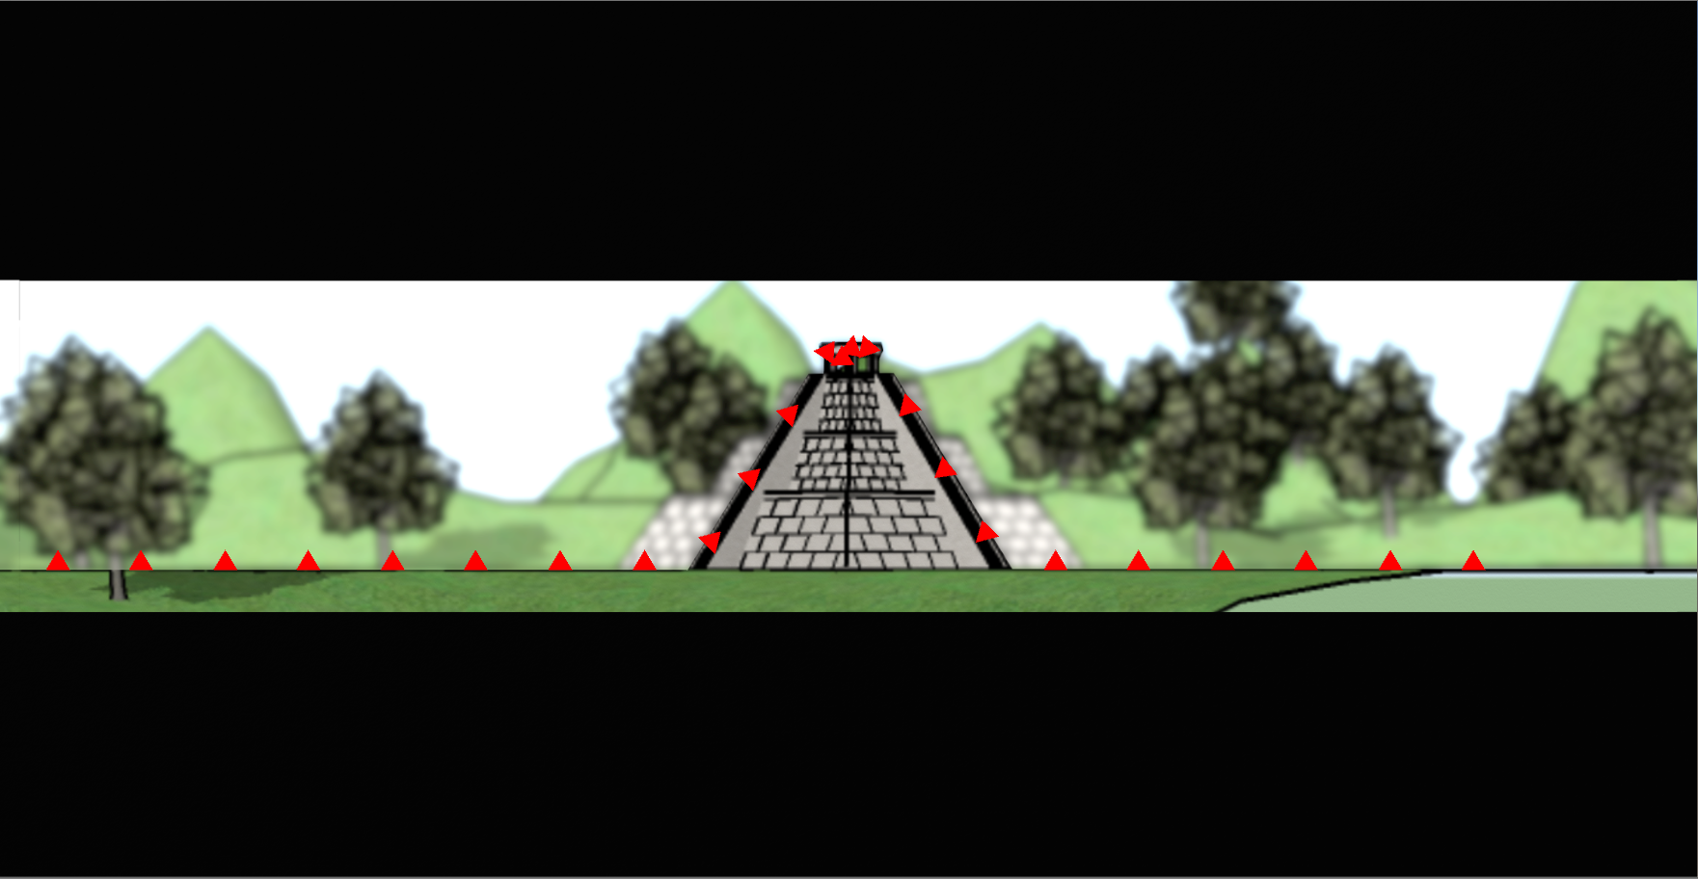
Early Progress

Slide 7
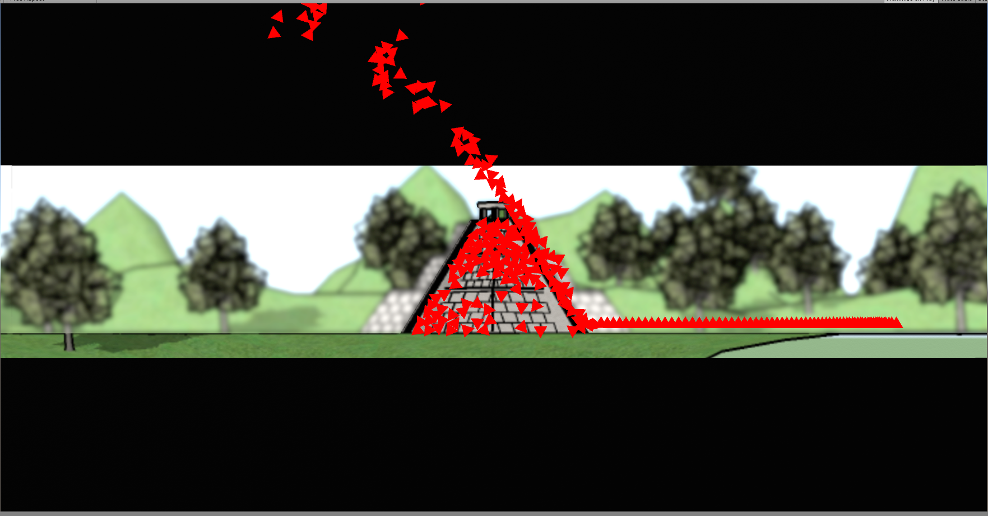
Early Progress

Slide 8
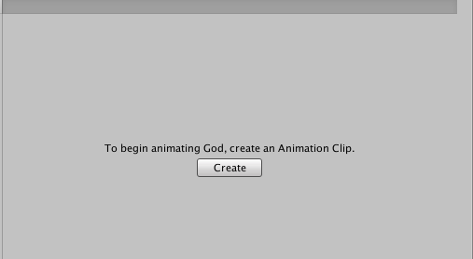
Early Progress

Slide 9
Challenges
Day 1 – getting force to work properly.
Day 2 – Unity + github, 3 people working on main scene. ARGHHH WAT. Legacy animation.
Day 3 – Waking up, UI and canons.

Slide 10
Final Game

